Slide 1
İDMANÇILARDA QULAQCIQ SƏYRİMƏSİ
PhD., DOS. DR. R.QABULOVA
ATU, MILLI IDMAN TIBB -REABILITASIYA ELMI-PRAKTIK INSTITUTU

Slide 2
İDMAN VƏ ÜRƏK XƏSTƏLİKLƏRİ ARASINDAKI U-ŞƏKİLLİ ASILILIQ
https://doi.org/10.1016/j.tcm.2015.06.005
Notes:
It has been suggested that moderate levels of exercise will have a protective effect and may even decrease the incidence of AF, whereas excessive endurance exercise heightens the risk of AF [9].
5.6.2.1 Patients without atrial fibrillation Moderate, regular PA is a cornerstone in the prevention of AF through modifying many of its predisposing factors.297,470473 Patients at risk of AF should therefore be motivated to exercise (see section 4.2). Conversely, AF is more prevalent in active and former male master athletes and those performing high-intensity endurance sports, suggesting a U-shaped relationship between habitual exercise and AF.471,474477 478481 This association has not been confirmed in women.474
The concept of a U-shaped pattern relationship between exercise dose and relative risk of developing AF may better explain these apparently contradictory data. According to this theory, regular mild to moderate exercise21,22 may provide a degree of protection from AF, while more sustained vigorous exertion could promote AF.10,15,20
Physical activity and exercise training reduce meta-bolic disease risk,1 improve cardiovascular health2 and mental well- being3 and are associated with healthy ageing.4 Studies also suggest that exercise can reduce the burden of arrhythmias, such as atrial fibrillation (AF),5 6 which is the most common cardiac arrhythmia worldwide
Notably, although sustained endurance training is associated with an increased AF burden [11–14], moderate exercise is associated with a reduction in AF risk in prospective epidemiological studies [15]. These data are now supported by a recent randomized controlled trial demonstrating a reduction in AF burden in an overweight population through moderate exercise [16]. The 2016 European Society of Cardiology (ESC) guidelines for the management of AF state that “moderate regular physical activity is recommended to prevent AF, while athletes should be counselled that long-lasting intense sports participation can promote AF” (Class of recommendation 1, Level of evidence A) [17]. Hence, the relationship between exercise and AF is complicated. This review aims to evaluate the current literature, in an attempt to assess at what point does exercise increase the risk of atrial fibrillation and represent too much of a good thing, and whether the negative impact of AF ever outweighs the clear benefits of exercise. Finally, the authors will review treatment options for atrial fibrillation in athletic individuals ( .
Curr Treat Options Cardio Med (2018) 20: 98 DOI 10.1007/s11936-018-0697-9
Regular exercise is proposed as a powerful tool for the primary and secondary prevention of cardiovascular disease, reducing most of the risk factors that predispose to AF, such as hypertension, diabetes mellitus, coronary artery disease and obesity.3,4 However, there is growing evidence that long-term endurance exercise may increase the risk of developing AF, with a reported 2–10 times greater prevalence in athletes and those who are involved in long-term sport participation.5

Slide 4
İDMAN NÖVLƏRİ
BACARIQ (USTALIQ)
GÜC
QARIŞIQ
DÖZÜMLÜLÜK
Sport disciplines and cardiac remodeling in elite university athletes competing in 2017 Taipei Summer Universiade. Medicine:
November 06, 2020 - Volume 99 - Issue 45 - p e23144 doi: 10.1097/MD.0000000000023144
Notes:
Type of Sport and Atrial FibrillationStudies have demonstrated that athletes who engage in endurance sports such as runners, cyclists and skiers are more prone to AF than other athletes.15-18,22,23,32
The exact mechanism involved remains unclear as other athletes who participate in boxing, wrestling, weight-lifting also practice strenuous sport practices, but AF does not appear to be as prevalent in those groups. The question remains – is this related to the type of sport? Unfortunately, little information exists relating to AF risk and sport specificity. Further research is warranted in this area

Slide 5
https://www.ncbi.nlm.nih.gov/pmc/articles/PMC4711509/
Notes:
Endurance athletes were defined as partici-pating in competitive athletics for at least 1500 lifetime hours in sports at the IB or IIA Bethesda classification or higher.

Slide 6
Hansı idman növündə AF riski daha yüksəkdir
https://www.ncbi.nlm.nih.gov/pmc/articles/PMC4711509/
Notes:
Atrial fibrillation (AF) is the most common arrhythmia in the athletic community and is more frequently observed in middle-aged than in young athletes.
summary, previous studies indicate a higher incidence of AF among athletes and former competitive athletes compared with the general population. However, this occurs predominately in middle-aged athletes engaged in sport activities over a long time period, which supports the concept that years of endurance training may be necessary before the development of AF. The lack of prospective studies where the exercise dose was accurately measured and the athletes were followed over many years does not allow at present the establishment of a threshold of lifetime hours of sport practice for AF development

Slide 7
Idmançılar arasında AF-nin meydana çıxma tezliyinin yaş və cins ilə əlaqəsi varmı
Canadian Family Physician • Le Médecin de famille canadien | Vol 61: december • décembre 2015

Slide 8
Tədqiqat xarakterli 1990 - 2 dekabr 2020 tarixində dərc olunmuş elmi məqalələr analiz olunmuşdur.
İdmançılarda AF inkişaf riski qeyri-idmançı idarələrə nisbətən əhəmiyyətli dərəcədə yüksəkdir (p<0.001, Z=4.97).
Məşq rejimi və AF riski arasında orta dərəcədə korrelyasiya var (B=0.1259, p=0.0193),
Qarışıq idman dözümlülük idmanından daha çox AF riski təşkil edir (B=-0.5476,p= 0.0204).
Gənc (<55 yaş) idmançılarda yaşlı (≥55 yaş) idmançılarla müqayisədə AF-nin inkişaf etmə ehtimalı daha yüksəkdir (B=−0,02293, p<0,001).
http://dx.doi.org/10.1136/bjsports-2021-103994

Slide 9
Risk amilləri - kişi cinsi, orta yaş, hündür boy, ümumi fiziki məşq müddəti 1500 - 2000 saat təşkil edir (competitive athletics for at least 1500 lifetime hours in sports)
Qaçış, velosiped və xizək yürüşü kimi dözümlülük idman növləri ilə məşqul olan şəxslər ən yüksək risk qrupu təşkil edir

Slide 10
İdmançılarda AF yaranma mexanizmi
Left atrial size of >4.0 cm
Vol 61: december • décembre 2015 | Canadian Family Physician •
Le Médecin de famille canadien 1
https://www.ncbi.nlm.nih.gov/pmc/articles/PMC5135187/figure/F1/
Notes:
The effects of exercise on the onset and progression of AF is complex. Triggers of AF in athletes may include atrial ectopy and sports supplements. Substrates for AF in athletes include atrial remodeling, fibrosis, and inflammation. Modulators of AF in athletes include autonomic activation, electrolyte abnormalities, and possibly, gastroesophageal reflux. Management of AF in athletes with rate-controlling agents and antiarrhythmic drugs remains a challenge and can be associated with impaired athletic performance. The value of catheter ablation is emerging and should be considered in suitable athletes with AF.
A large population study including 163,627 patients reported that acid reflux disease increased the risk of AF by 39%
Pathophysiology
The mechanisms by which exercise contributes to AF are not well understood and are presumed to be multifactorial (Figure 1). It is accepted that the initiation and perpetuation of AF requires a trigger, a modulator and a substrate. The mechanism of AF in athletes may be attributable to the interaction among these three factors. A specific trigger (atrial ectopy, sports supplements and illicit drug use) in the presence of a suitable substrate (genetic predisposition, inflammation, fibrosis and cardiac remodeling) and a modulator (autonomic activation, electrolyte abnormalities, acid reflux disease) remains the foundation in onset and maintenance of AF in athletes.
There is substantial evidence that endurance training results in exaggerated vagal tone, cardiac remodeling, inflammation and fibrosis, all of which may contribute to the onset of AF in athletes.
The mechanism of AF in athletes is unclear and likely multifactorial. The three suspected etiologies include anatomic changes, alterations in the autonomic nervous system, and a sustained inflammatory response predisposing athletes to AF (¹⁴). Endurance training is associated with increased left and right atrial size; however, the clinical and arrhythmogenic consequences of this enlargement have been debated widely (¹⁹). A study by Pelliccia et al. (¹⁸) of 1,777 highly trained athletes examined at the National Institute of Sports Medicine from 1992 to 1995 with an average age of 24 ± 6 years was assessed for the prevalence, clinical significance, and arrhythmic consequences of left atrial enlargement. They found 347 athletes (20%) to have left atrial enlargement with transverse dimensions ≥ 40 mm. However, AF occurred equally in athletes that had atrial enlargement (0.28%) and in athletes that did not have atrial enlargement (0.27%) (¹⁹). While this study showed a significant number of athletes having atrial enlargement (20%), its ability to detect a relationship with AF may have been related to the low prevalence of AF (0.3%). This low prevalence was related likely to the relatively young age of the study population. A small case-control study of 45 athletes showed biochemical evidence of distribution of the collagen equilibrium that would favor fibrosis compared with sedentary controls (^{15b,21}). This concept of fibrosis was examined also in a study performed on male Wistar rats that were conditioned to run vigorously for 4, 8, and 16 wk and compared with time-matched sedentary rats. It was found that at 16 wk, the exercise rats developed eccentric hypertrophy and diastolic dysfunction together with atrial dilation with collagen deposition in the right ventricle and that there were significantly greater protein expressions of fibrosis markers in both atria and the right ventricle than in the sedentary rats (²¹). These fibrotic changes were reversed after an 8-wk exercise cessation period. These findings are yet to be confirmed in human studies.
Swanson (²⁰) has made the hypothesis that older athletes with AF, but otherwise healthy, who have engaged in rigorous aerobic endurance exercise for more than a decade will have C-reactive protein (CRP) levels that are higher than those athletes without AF. If this hypothesis was validated, one could then consider a prospective clinical trial of anti-inflammatory therapy in athletes. While there are studies on the individual pieces of this hypothesis, there is no study that addresses all three components: inflammatory markers, AF, and athletes. There have been studies that have shown that prolonged, intense endurance exercise acutely increases serum concentrations of the inflammatory markers: interleukin-6 and CRP (^{19,20}). While regular moderate endurance exercise training generally reduces inflammatory markers, high-intensity exercise such as a marathon race may transiently produce a sustained systemic inflammatory response and elevated CRP levels (^{19,20}). This systemic inflammatory response is postulated by some to be a central part of “overtraining syndrome” or excessive training that results in deterioration of performance (²⁰). This would coincide also with the ESC statement that in population-based studies, the intensity of physical activity showed a U-shaped relationship with the incidence of AF, which may indicate that the positive antiarrhythmic effects of physical activity are negated partially when exercise is too strenuous (⁵). Separate studies have noted an association between elevated CRP levels and both the presence of AF and the risk of developing AF (^{19,20}). Lastly, separate studies report that medications with anti-inflammatory properties, such as glucocorticoids, statins, angiotensin-converting enzyme inhibitor, and angiotensin II receptor blockers (ARBs), seem to reduce recurrence of AF (²⁰).
Physiologic adaptations associated with intense exercise are known as “athletes heart” and generally serve to meet the increased oxygen demand of skeletal muscle during rigorous activity (²²). Increased parasympathetic tone and reduced sympathetic tone at rest are characteristics of aerobically trained athletes and result in resting bradycardia (¹⁹). The GIRAFA study demonstrated that 70% of patients with lone AF (the predominant type of AF in athletes) had vagal AF (²¹). Augmented vagal tone shortens the atrial refractory period and facilitates reentry and the appearance of AF (^{19,21}).
Cardiac Remodeling
There is ample evidence that endurance exercise is associated with both bi-atrial and ventricular enlargement which can occur independent of each other.8 was noted in 20% of athletes who participated in competitive sports.42
Mont and colleagues reported increased left atrial longitudinal, anteroposterior and transverse diameters and volumes with exercise.19
Atrial enlargement is reported to be related to the lifetime hours of exercise.43
https://www.ncbi.nlm.nih.gov/pmc/articles/PMC5135187/figure/F1/

Slide 11
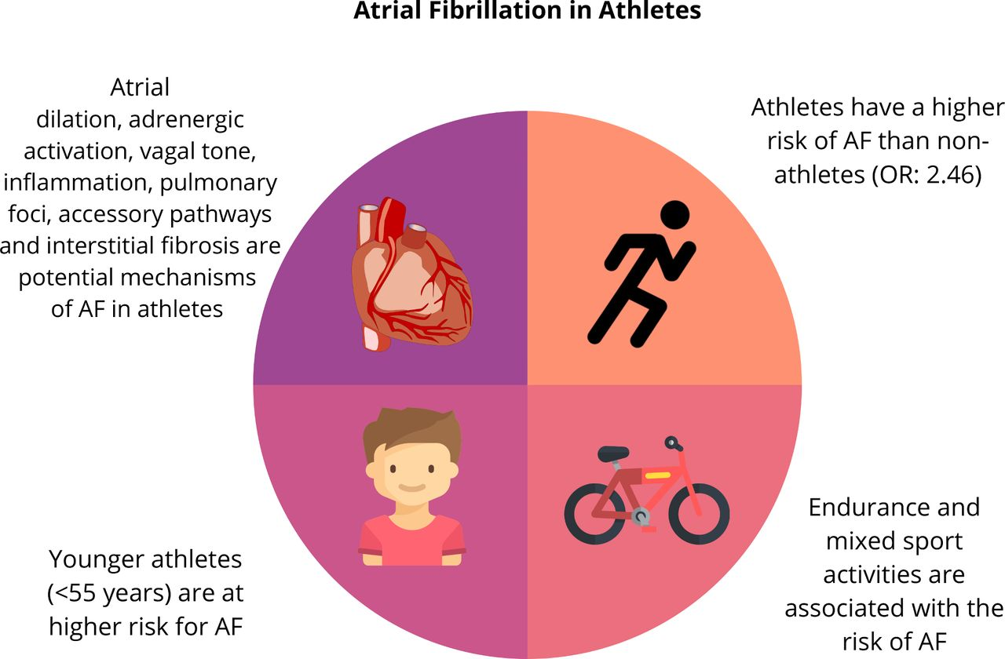
Central illustration of the main study outcomes.
William Newman et al. Br J Sports Med 2021;55:1233-1238
Copyright © BMJ Publishing Group Ltd & British Association of Sport and Exercise Medicine. All rights reserved.
Notes:
Central illustration of the main study outcomes. AF, atrial fibrillation.

Slide 12
Triggerlər
İdman qida əlavələri, hətta qeyri-rəqabətli səviyyədə olsa belə, müntəzəm məşq edən və idmanla məşğul olan şəxslər tərəfindən istifadə edilir.
Peşəkar idmançılar performansı yaxşılaşdırmaq üçün bəzən Ümumdünya Antidopinq Agentliyi (WADA) tərəfindən qadağan olunmuş qeyri-qanuni və ya performansı artıran dərmanlardan istifadə edirlər
Gənc idmançılarda anabolik steroidlərlə əlaqəli AF riskinin artması halları qeyd olunmuşdur. Lakin anabolik steroidlərin AF riski ilə bağlı sistematik tədqiqatlar yoxdur.
Enerji içkiləri - tərkibində yüksək dozada kofein (50 mq-dan 500 mq-a qədər), taurin, jenşen, s kimi stimulyantlar və riboflavin, pantoten turşusu və tiamin var. Hətta sağlam insanlarda AT-nin 10 mmHg, ÜVS 5-7 döyüntü/dəqiqədə artmasına səbəb ola bilər.
Hazırda enerji içkilərinin EKQ -də dəyişikliklər ilə əlaqəsinə dair obyektiv məlumat yoxdur.
https://www.ncbi.nlm.nih.gov/pmc/articles/PMC5135187/
Notes:
We currently lack objective data on the electrocardiographic effects of energy drinks. One study reported that heavy consumption of energy drinks in healthy individuals can contribute to a transient increase in both blood pressure of 10 mmHg and heart rate of 5-7 beats/minute.41 However, long-term data concerning the risk of chronic consumption of energy drinks, especially in middle aged individuals who also have other medical comorbidities in triggering AF are lacking.

Slide 13
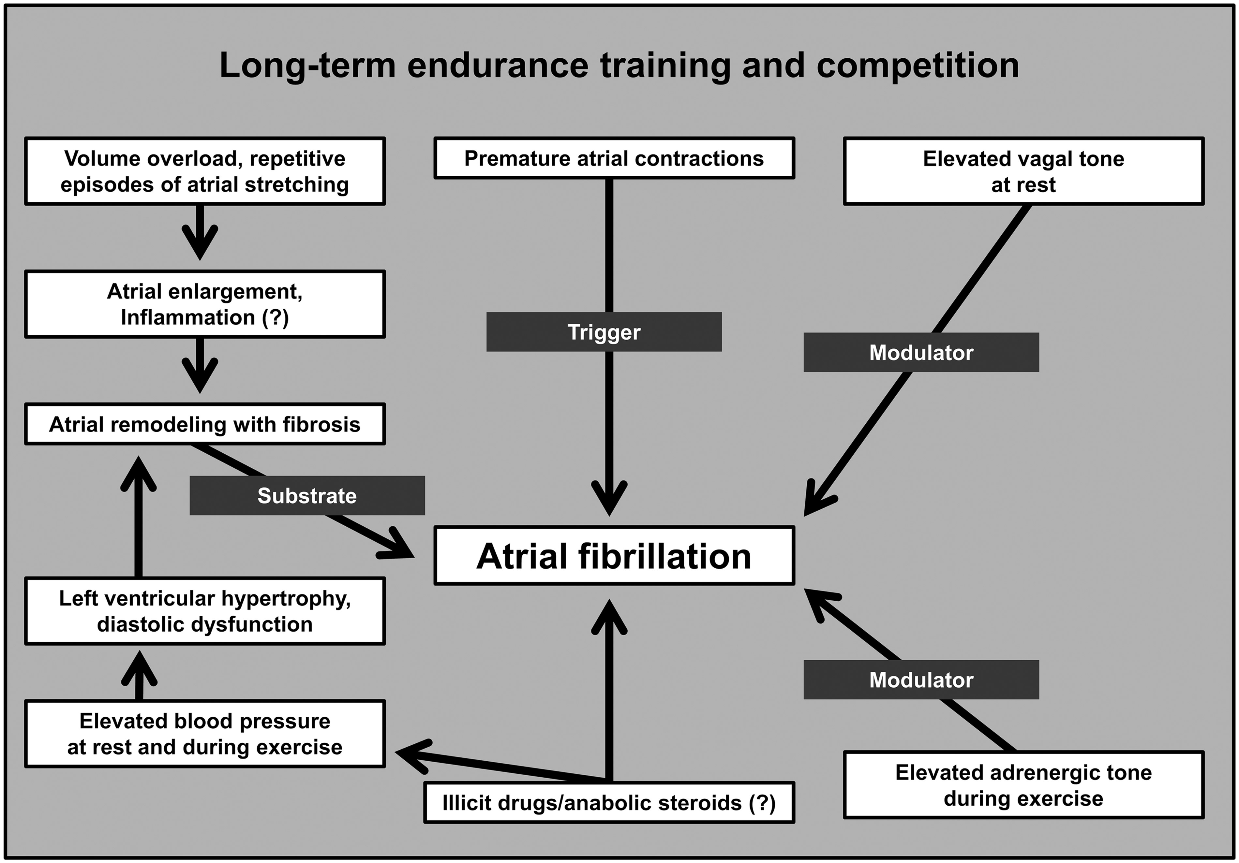
Figure 1. Synopsis of factors influencing the development of atrial fibrillation in athletes.
Notes:
Figure 1. Synopsis of factors influencing the development of atrial fibrillation in athletes. A multifactorial mechanism concerning the role of intense and long-term exercise in the development of AF has been proposed (see Figure 1). Atrial anatomic adaptations due to chronic volume or pressure overload, alterations in autonomic nervous system, chronic systemic inflammation and fibrosis have been suggested as potential mechanisms. However, all these associations still remain speculative.24,25 Fluid shifts and electrolyte abnormalities occurring during vigorous exercise may also trigger AF,26 whereas the use of illicit drugs may be associated with the arrhythmia.27 Nevertheless, it is essential in the work-up of the arrhythmia to exclude any underlying structural (hypertension, cardiomyopathy, myocarditis) or electrical (Wolff-Parkinson-White syndrome [WPW], concealed pathways, channelopathies) substrate for AF as well as extracardiac causes like thyrotoxicosis, as a considerable percentage of athletes with AF may have underlying pathologies.
Atrial Anatomic Adaptation
Even though AF in athletes is considered predominately lone,10,12 evidence of atrium structural alterations, such as enlarged left atrial dimension,17 put this definition into question, raising additional concerns as to whether exercise-induced atrial remodelling is necessarily a benign adaptation to exercise conditioning.
Endurance exercise training is associated with increased left and right atrial size, probably due to long-standing volume and/or pressure overload. Although these conditions can precipitate AF, either by shortening atrial effective refractory period28 and/or eliciting more atrial ectopics, this has yet to be proved in clinical studies. Indeed, Pelliccia et al.17 showed that athletes involved in regular endurance practice have a larger atrium when compared with sedentary controls without this increased size predisposing per se to AF. Furthermore, Baldesberger et al.6 did not find an increased prevalence of atrial ectopy in former professional cyclists in contrast with older studies connecting atrial ectopic activity and physical activity.29
The concept of atrium fibrosis as consequence of long-term intensive exercise training derives exclusively from animal models, while data from athletes’ hearts are non-existent. An increase in mRNA and protein expression of a series of fibrotic markers in the right ventricle and both atria was found in rats exercised for 16 weeks compared with sedentary rats.30 In contrast, histological remodelling in athletes’ ventricles was reported by few clinical studies supporting the concept of fibrosis in humans following long-term engagement in exercise.31,32
Inflammation
The hypothesis that inflammation may play a significant role for AF in athletes derives from many studies that have demonstrated an increase in inflammatory markers such as cytokines interleukin 1 (IL-1), IL-6 and C-reactive protein (CRP) in response to intensive or prolonged endurance exercise.25,33,34 The relationship between elevated inflammatory markers and the risk for developing AF has also been proved.35,36 Nonetheless, this concept remains speculative since no data concerning the association between exercise intensity, amount of inflammation and risk for AF in athletes exist so far.
Autonomic Nervous System
Vagal AF is the prevailing type of AF in athletes.10 A recent study confirmed the relationship between increased vagal tone and AF in middle-aged healthy men.37 The hyperactivity of vagal tone in athletes acting synergistically with a high level of sympathetic activation during training, produce significant shortening of atrial refractory period and increase dispersion of repolarisation, creating the proper conditions for initiation and perpetuation of AF.38–41

Slide 14
Kliniki yanaşma
Anamnez - trigger (tətikləyici) amillərin müəyyənləşdirilməsi
AF epizodlarının Fiziki aktivlik ilə əlaqəsi (simpatik mənşəli AF)
Gecə ürəkdöyünmə tutmaları (vaqus mənşəli AF)
Məşqsonrası, sakitlik, qida qəbulundan sonra AF epizodları (vaqus mənşəli AF)
Soyuq/isti təsiri ilə reabilitasiya prosedurları (vaqus mənşəli AF)
Alkoqol, stimulyantlar, anabolik steroidlərin, s. qəbulu
Ezofageal reflüksun olması ( həmçinin vaqus mexanizmi)
Həftədə neçə saat müntəzəm dözümlülük (intensiv) idman növü ilə məşqul olması

Slide 15
Müayinələr
AF-yə səbəb ola biləcək ekstrakardial səbəblərin aşkar olunması və struktur (hypertension, cardiomyopathy, myocarditis), elektrik (Wolff-Parkinson-White sindromu, gizli keçirici yollar, kanalopatiyalar) substratının müəyyənləşdirilməsi
Fiziki yük sınaqları - maksimal ÜVS-nın, AT və VO2 max müəyyənləşdirilməsi və yükləmə ilə bağlı simptomları və aritmiyaları aşkar etməyə imkan verir.
Arterial təzyiqin vaxtaşırı ölçülməsi (AH-nı inkar etmək məqsədilə)
Laborator müayinələr (elektrolit tarazlığının pozulması (Na, K, Ca, dehidrotasiya səbəbli dəyişiklkilər), tiroid testləri s.)
AHA və ACC - AF olan idmançılara aşağıdakı müayinələri tövsiyə edir: performance-artıran/qadağan dərman istifadəsi barədə anket, tiroid funksiyası testləri, EKQ, ExoKQ (Sinif I).

Slide 16
AF-nin qeydə alınması
Sakitlik 12-aparmalı ECG,
Holter və uzaqdan EKQ monitorlanması
Müasir taxıla bilən cihazlar, 'patch' cihazlar, smartfon app, smartwatch ('ağıllı' qol saatları) idmançılar üçün daha uyğundur

Slide 17
İDMANÇILARDA AF-nin İDARƏ OLUNMASI
ritm və ya ÜVS-na nəzarət strategiyası ilə simptomların qarşısının alınması
tromboembolik riskdən qorunma və
risk faktorlarının modifikasiyası
AF olan idmançı ilə qarşılaşdıqda üç unikal problem var
seçilmiş terapiya məşq performansını pozmadan AF-yə nəzarət etməlidir.
bu terapiya idmançının ÜADA tərəfindən qadağan olunmuş maddələrin siyahısına uyğun olmalıdır.
optimal antikoaqulyasiya strategiyasının nəzərdən keçirilməsinə məşqlə bağlı qanama riskinin qiymətləndirilməsi daxil edilməlidir.
Notes:
In the absence of RCTs, recommendations for AF management in . athletes are based largely on evidence in non-athletes, observational . data, and expert consensus.143 The need for anticoagulation is deter- . mined by clinical risk factors. Sports with direct bodily contact or . prone to trauma should be avoided in patients on OAC.
Management of AF in Athletes
Due to the paucity of data investigating athletes with AF, many of the current recommendations are based upon expert consensus and extrapolation from evidence in non-athletes. Similar to non-athletes, the mainstay of management is prevention of symptoms with a rhythm or rate control strategy, protection from thromboembolic risk and modification of risk factors. However, there are three unique challenges when faced with an athlete with AF. First, the chosen therapy should control AF without impairing exercise performance. Second, this therapy must comply with the list of prohibited substances by the athlete's respective sporting body. Third, consideration of the optimal anti-coagulation strategy must include assessment of the training-related bleeding risk.

Slide 18
İdmandan (müvəqqəti) ayrılma Detraining
Heyvan molellərində təsdiq edilmişdir ki, fiziki aktivliyin intensivliyinin azalması AF -epizodlarının təkrarlanması hallarını azaldır (Guasch E, J Am Coll Cardiol 2013).
Sinus ritmini bərpa etmək üçün 2 ay müddətində idman fəaliyyətinə fasilə vermək tövsiyə olunurdu (Heidbuchel H., 2006)
Beləki məşq həcminin azalması vegetativ tarazlığı adrenergik tonusa tərəf dəyişməyə səbəb ola bilir
İdman məşqlərinin məhdudlaşdırılmasının psixoloji nəticələri idmançı ilə müzakirə edilməlidir və idmançılarda psixoloji dəstəyə ehtiyac ola bilər*
Bununla belə, dözümlülük məşqlərinin həcminin azaldılması bütün xəstələrdə AF residivinin qarşısını almaq üçün kifayət olmaya bilər*.
Veteran idmançılar idman həyatına alışdıqları üçün tez-tez alternativ müalicə variantlarına üstünlük verirlər*.
*https://academic.oup.com/eurjpc/article/21/8/1040/5925801
Notes:
The 36th Bethesda Conference[69] recommended that athletes with asymptomatic AF can safely participate in any competitive sports in the absence of structural heart disease with maintenance of appropriate ventricular rate with no decrease in functional capacity when they were in sinus rhythm.

Slide 19
RATE vs RİTM control?
Ritm kontrol yanaşmasına üstünlük verilir, çünki ÜVS -na adekvat nəzarətə (rate control) baxmayaraq, idmançılar simptomatik olaraq qalır (Prashant Rao, JACC, 2019)
Amiodaron (class III) uzun müddətli istifadəsi toksik təsirinə görə arzuolunmazdır. Həmçinin açıq havadakı idmanda fotosensibilizasiya səbəbindən pis tolere edilir (J.Walter et al. Arch Dermatol. 1984 Dec. )
Beta-blokatorlar, AF residivlərinin qarşısının alınmasında məhdud effektivliyə malikdir, idmançılar da vaqal tonusun yüksək olması səbəbindən çox vaxt yaxşı tolere edilmir. Ümumdünya Antidopinq Agentliyinin xüsusi idman növləri üçün qadağan olunmuş siyahısına daxil edilib (ESC 2020 tövsiyələri)
Vaqal fonda paroksizmal AF-də Class IC antiaritmik strategiyaya üstünlük verir (flecainide - 'pill-in-the-pocket’). Uzunmüddətli qəbulu zamanı aritmogen effektini nəzərə alınmalıdır
Pulmonar vena izolyasiyası nəinki təkrarlanan AF və dərman müalicəsinə tolerant və ya dərman müalicəsinə qeyri-tolerant olan idmançılarda, həmçinin birinci seçim terapiya kimi intensiv dözümlülük idman növləri ilə məşqul olan idmançılarda istifadə oluna bilər.
Lakin AF-nin çoxamilli etiologiyasını nəzərə alaraq, dözümlülük idman növlərində aritmiyanın təkrarlanması və təkrari prosedura ehtiyac olma ehtimalı nəzərə alınmalıdır
Ablasiya procedurundan 2-12 həftə sonra idmana davam etmək olar (Raju H, Heart Lung Circ 2018)
Notes:
In our practice, we prefer a rhythm control strategy as athletes are often symptomatic in AF despite adequate rate control. Additionally, rate control is often limited by physiologic resting sinus bradycardia. We prefer a Class IC antiarrhythmic strategy such as flecainide as a 'pill-in-the-pocket' approach. Class IC anti-arrhythmic agents reduce the risk of AF recurrence more so than beta-blockers and have a better safety profile than class IA drugs in non-athletes.²⁷ Ideally the first dose is taken under direct observation in the hospital in order to mitigate against the risk of adverse events, which occurs in roughly 5%.²⁸ Although not well explored in athletes, disopyramide (Class IA), through its anticholinergic effect, may provide benefit in vagal mediated AF in athletes. However, until further studies demonstrate its benefit in this cohort, we remain cautious in its use due to an association with a small increase in mortality for paroxysmal AF.²⁷
Pulmonary vein isolation by means of radiofrequency catheter ablation is an established treatment for AF in non-athletes and may be a useful option for athletes with recurrent AF refractory to medical treatment or intolerant of medical therapies. In a 3-year follow-up of 94 predominantly male athletes with paroxysmal AF, Koopman et al. showed a similar rate of AF recurrence between athletes and controls.²⁹ In this study, non-endurance athletes required more ablations than endurance athletes within the three year period.²⁹ For athletes who undergo an ablation procedure, they can typically return to play after 2-12 weeks.³⁰ We direct the reader to the following references that provide an overview in support and against catheter ablation for AF in athletes, respectively.^{31,32}
Antiarrhythmic drugs represent a reasonable choice in some athletes with AF. Flecainide may be used regularly or as a “pill in the pocket” for athletes with vagal-mediated paroxysmal AF in the absence of structural heart disease. Caution is recommended with flecainide because of the risk of proarrhythmia due to intense adrenergic hypertonia during professional sports.
The effectiveness of catheter ablation, particularly pulmonary vein isolation, in endurance athletes is partly due to younger age and absence of diseased atria. However, the multifactorial etiology of AF in endurance athletes may be partly responsible for arrhythmia recurrence which may require a repeat procedure. Pulmonary vein isolation should be considered as a first-line therapy in endurance athletes with atrial fibrillation for arrhythmia-free survival, improvement in exercise capacity so that one can resume endurance sports practices. A redo-ablation procedure may be considered with recurrence.
https://www.ncbi.nlm.nih.gov/pmc/articles/PMC5135187/#R22
Several middle-aged endurance athletes may have brief episodes of atrial arrhythmia which can be triggered both increased resting vagal tone and sympathetic activation during intense physical exertion. The question remains as to whether such athletes can safely continue training. Currently, there are no guidelines on how best to manage such arrhythmias in the aging athlete. Pulmonary vein isolation via catheter ablation may be an effective strategy in these patients.
Management
Treatment of AF in athletes with either rate or rhythm control medications can be challenging. Identification of overtraining in athletes is important as reduction or temporary cessation of exercise may decrease or even prevent AF recurrence. The initial approach should be to recommend reduction of physical activity. A study of 1772 athletes with a mean follow up of 62 months reported disappearance of AF with detraining.9 Similarly, Hoogsteen et al21 reported that sports abstinence improved symptoms of AF in athletes. Rate control agents such as beta-blockers or calcium channel blockers may decrease performance and should be avoided, if possible, in professional athletes. Antiarrhythmic drugs represent a reasonable choice in some athletes with AF. Flecainide may be used regularly or as a “pill in the pocket” for athletes with vagal-mediated paroxysmal AF in the absence of structural heart disease. Caution is recommended with flecainide because of the risk of proarrhythmia due to intense adrenergic hypertonia during professional sports. Disopyramide, a class IA antiarrhythmic drug, was shown to be effective in vagal-mediated and bradycardia-dependent AF. Early small studies with disopyramide in post-cardioversion patients reported maintenance of sinus rhythm in 67% patients at 6 months and 54% at 1 year.67,68 Disopyramide is poorly-tolerated due to antimuscarinic properties and proarrhtyhmic effects.Amiodarone a class III antiarrhythmic agent, is a potent rhythm control medication. Caution is required due to long-term toxic effects. There are no studies on the efficacy of angiotensin converting enzyme inhibitors, aldosterone antagonists and statins in vagal-mediated AF related to endurance sports.

Slide 20
Mayo Clinic şəbəkəsində 1427 kateter ablasiyası aparılmlş, 2004–2018 illərdə KA keçirmiş xəstələr retrospektiv qiymətləndirilib.
39 dözümlülük idmanı ilə məşqul olan idmançıların 77% KA-dan sonra əvvlki səviyyədə idmanı davam etdirib.
KA keçirmiş yüksək dözümlülük idman növləri ilə məşqul olan idmançılarda aritmiyanın əsasən AFL olmaqla təkrarlanma hallarına daha çox rast gəlinir.
https://onlinelibrary.wiley.com/doi/epdf/10.1002/joa3.12746
Notes:
1427 patients at Mayo Clinic sites underwent catheter ablation procedures during the study period, 174 were identified as potential high-endurance athletes.
We retrospectively identified endurance athletes who underwent catheter ablation at our institution (2004–2018).
Primary endpoints were freedom from atrial ar-rhythmias at 12, 24, and 36 months after the procedure. Secondary endpoints were defined as qualitative improvement in symptoms allowing athletes to return to their previous level of activity. Athletes were compared with a control group of nonathletes in a 3- to- 1 matched analysis by age and sex.Results: A total of 39 endurance athletes who underwent catheter ablation were identified during the study period. At 12 months, there was no difference in treat-ment outcomes for athletes versus nonathletes (relative risk [RR], 1.06; 95% CI, 0.92– 1.22; p= .40). Freedom from atrial arrhythmias was 35% less likely in athletes than nonathletes at 24 months (RR, 0.65; 95% CI, 0.50–0.83; p< .001) and 42% less likely at 36 months (RR, 0.58; 95% CI, 0.41–0.79; p< .001). Overall, 77% of the athletes were able to return to their previous level of activity following catheter ablation.Conclusion: Endurance athletes with atrial fibrillation appear to have higher rates of atrial arrhythmia recurrence than nonathletes after catheter ablation, with higher rates of atypical flutter. The majority of athletes were able to return to their previous level of activity after ablation

Slide 21
Tromboembolik Risk
CHA2DS2-VASc risk stratifikasiyası sxemi tromboembolik hadisələrin həqiqətən aşağı riski olan AF xəstələrini etibarlı şəkildə müəyyən edir.
CHA2DS2-VASc şkalası ilə 0-1 bal riski olan idmançılarda AF antikoaqulyasiyaya ehtiyac olmadan idarə oluna bilər.
Antikoaqulyasiyaya ehtiyacı olanlarda, idmanla bağlı qanaxma riskinə qarşı antikoaqulyasiyanın faydasını qiymətləndirmək vacibdir.
Antikoaqulyant qəbulu zamanı idmançı travmatik idmandan uzaqlaşdırılmalıdır
Məşq etməyə davam edən idmançılarda ənənəvi risk faktorları mövcud olduqda, antikoaqulyasiya üçün səbəb kimi qəbul etmək əvəzinə, onları dəyişdirilməyə cəhd edilməlidir.
İdmançılarda sol qulaqcıq seyvanının qapanması antikoaqulyasiya terapiyası ala bilməyənlərdə faydalı ola bilər .
Notes:
Several middle-aged endurance athletes may have brief episodes of atrial arrhythmia which can be triggered both increased resting vagal tone and sympathetic activation during intense physical exertion. The question remains as to whether such athletes can safely continue training. Currently, there are no guidelines on how best to manage such arrhythmias in the aging athlete. Pulmonary vein isolation via catheter ablation may be an effective strategy in these patients.
Thromboembolic Risk
Similar to non-athletes, thromboembolic risk is paramount in the management of AF in athletes, regardless of whether a rate- or rhythm control strategy is preferred. The CHA2DS2-VASc risk stratification scheme reliably identifies 'lone' AF patients who are at truly low risk of thromboembolic events.³³ Therefore, athletes who score zero can be adequately reassured without necessitating anti-coagulation. In those that warrant anticoagulation, it is important to weight the benefit of anticoagulation against the bleeding risk related to training. When conventional risk factors are present in athletes who continue to train, an attempt should be made to reverse or modify these rather than view them as an indefinite reason for anticoagulation. Although not well documented in athletes, left atrial appendage occlusion may be useful in those unable to take anticoagulation therapy.
In low risk athletes such as those with a CHA2DS2-VASc score of 0-1, no antithrombotic therapy is recommended. For CHA2DS2-VASc scores of ≥2, oral anticoagulation is recommended with warfarin or one of the novel oral anticoagulants. There are no data regarding the safety of novel oral anticoagulants in athletes with AF. Any form of oral anticoagulation can be a challenge due to increased risk of bleeding with sports activates.

Slide 22
RİSK AMİLLƏRİNİN DƏYİŞDİRİLMƏSİ

Slide 23
1. AF olan idmançılar tiroid testləri, anketkəşmə, EKQ və exokardioqramma daxil olmaqla müayinə keçməlidirlər. (Class I; Level of Evidence B).
2. Yaxşı tolere edilən və öz-özünə dayanan aşağı riskli AF olan idmançılar terapiya olmadan bütün rəqabətli idman növlərində iştirak edə bilərlər (Class I; Level of Evidence C).
3. AF olan idmançılarda, aspirindən başqa antitrombotik terapiya göstərişdirsə, qanaxma riskini xüsusi idman kontekstində nəzərə almaq məqsədəuyğundur (Class IIa; Level of Evidence C).
4. AF üçün kateter ablasiyası sürətə nəzarət və ya antiaritmik dərmanlara ehtiyacı aradan qaldıra bilər və nəzərə alınmalıdır (Class IIa; Level of Evidence B).
https://www.ahajournals.org/doi/epdf/10.1161/CIR.0000000000000245
Notes:
Atrial Fibrillation
There are some data suggesting that athletes are at increased risk of AF, and in particular vagally mediated AF (8,9,11). Athletes may be particularly prone to AF because of the high vagal tone associated with extreme fitness, as well as cardiac remodeling, which includes changes in chamber size and pressure. Other causes, including fibrosis, inflammation, and sympathetic discharge, can also play a role. All athletes with AF should undergo a workup that includes thyroid function tests, ECGs, echocardiograms, and queries for drug use, including performance-enhancing agents and illicit drugs. Athletes with AF should be evaluated for hypertension and coronary artery disease. Further testing is warranted in some cases, including cardiac magnetic resonance imaging and stress
Zipes et al. 5 Competitive Athletes: Arrhythmias and Conduction Defects
testing. Patients with underlying cardiac disease such as dilated cardiomyopathies, hypertrophic cardiomyopathy, Brugada syndrome, and catecholaminergic ventricular tachycardia (VT) have an increased risk of AF. AF in a child or adolescent athlete is uncommon and should suggest a familial inheritance or the presence of an accessory pathway.
The management options for AF in athletes include rate control or rhythm control. Rate control, although an op- tion, may not be ideal for competitive athletes because of the focus on performance and difficulty ensuring adequate rate control during an athletic performance. A rhythm control strategy is thus the preferred method of treatment in athletes. Rhythm control can be achieved with antiar- rhythmic agents or ablation procedures. Increasingly, ablation has shown a sustained benefit, particularly in those with paroxysmal AF in the presence of a normal heart, which would likely be most athletes with AF (12); however, longer-term observations are necessary to determine benefits over many years. Antiarrhythmic drug therapy has efficacy and side effect concerns, including proarrhythmic risk. In some cases, withdrawal from com- petitive sports or attempts at deconditioning might be chosen. Conversely, some athletes may choose to avoid any therapy and still participate because they tolerate short episodes of AF during competition.
The other component of management is anticoagulation. Most athletes will have a low risk of systemic thromboem- boli as manifested by a low CHADS2 score or a CHA2DS2- VASC score of zero, and anticoagulation will rarely be necessary. If anticoagulation is used, athletes should be restricted from participation in high-impact contact sports because of the bleeding risk.

Slide 24
Tövsiyələr | Class | Level
AF-nin qarşısını almaq üçün müntəzəm fiziki aktivlik tövsiyə olunur | I | A
İdmanla məşğul olmazdan əvvəl struktur ürək xəstəliklərinin, tiroid disfunksiyası, alkoqol və ya narkotik istifadəsi və ya AF-nin digər əsas səbəblərinin qiymətləndirilməsi və idarə olunması tövsiyə olunur. | I | A
Uzunmüddətli intensiv idmanla məşqul olan AF olan şəxslərə xüsusən də orta yaşlı kişilərə intensiv idmanla məşğul olmanın AF-yə (təkrarlanmasına) təsiri ilə bağlı melumatlandirma tövsiyə olunur. | I | B
Təkrarlanan simptomlu AF olan və/və ya atletik performansa təsirini nəzərə alaraq, dərman müalicəsindən iimtina edən şəxslərdə AF ablasiyası tövsiyə olunur. | I | B
AF ilə hər bir şəxsdə məşq zamanı mədəciklərin VS nəzərə alınmalıdır (simptomlar və/və ya EKQ monitorinqi ilə) və ÜVS-na (titrlənmiş) nəzarət tətbiq edilməlidir. | IIa | C
Struktur ürək xəstəliyi olmayan və AF-yə yaxşı dözümlülüyü olan şəxslərdə antiaritmik terapiyasız idmanla məşğul olma nəzərdən keçirilməlidir | IIa | C
Sənədləşdirilmiş qulaqcıq titrəməsi olan, intensiv məşq etmək istəyən şəxslərdə, 1 : 1 AV keçiricilik ilə qulaqcıq titrəməsinin profilaktikası məqsədilə Cavo-tricuspid isthmus ablasiyası nəzərdən keçirilməlidir | IIa | C
Sinif I antiaritmik dərmanlar monoterapiya şəklində intensiv fiziki məşq zamanı AF/AFL-də adekvat ÜVS -nı təmin etmirsə, tövsiyə olunmur | III | C
Pill-in-the-pocket flecainide və ya propafenone qəbulundan sonra 2 yarım-parçalanma dövrü keçmədən (2 günə qədər) intensiv idman tövsiyə olunmur | III | C
Antikoaqulyant qəbul edən şəxslərə birbaşa bədən təması və ya zədələnmə riski olan idman tövsiyə olunmur | III | A
https://www.ncbi.nlm.nih.gov/pmc/articles/PMC4711509/

Slide 25
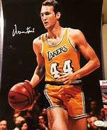
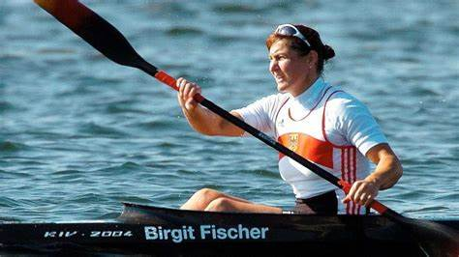
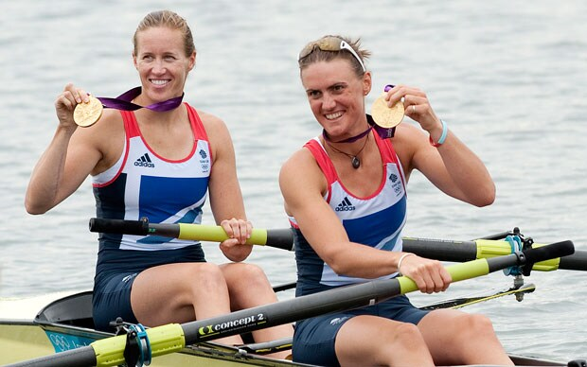
AF-li YÜKSƏK NƏTİCƏLİ İDMANÇILAR
1.Larry Bird: 12 times NBA All-Star - continued to play with episodes of AF
2. Billie Jean King: Tennis Star-after ablation continues exercise and educate pts
3. Haimar Zubeldia: Cyclist continued to spots after AF treatm. and rest for sev. months
4. Jerry West: NBA All-Star Had Atrial Fibrillation Attacks While Playing-AF diagnosed after he had retired
5. Karsten Madsen: Triathlete - refused Ablation and continued sports
6. Mardy Fish: Left Tennis after ablation, shifted to the golf
7. Birgit Fischer: Olympic Canoe Racer - AF found during routine medical checks -stopped Competing
8. Nicola Coles: Olympic Rower -took magnesium and fish oil supplements
9 World-Class Athletes With Atrial Fibrillation | Everyday Health
Notes:
Definitions
It is important to understand the terms used to describe AF since study results and treatment recommendations are related often to a specific type of AF. The American College of Cardiology (ACC), American Heart Association (AHA), and the European Society of Cardiology (ESC) recommend in their guidelines the following classification system: first diagnosed AF, paroxysmal AF, persistent AF, long-standing persistent AF, and permanent AF (⁵). Every patient who presents with AF for the first time is considered a patient with first diagnosed AF. Paroxysmal AF is self-terminating, usually within 48 h, but up to 7 d. Persistent AF is when the episode lasts longer than 7 d or requires termination by cardioversion with drugs or direct current. When AF has lasted for more than 1 year, it is considered long-standing persistent AF. Permanent AF is said to exist when the patient and physician accept the presence of the arrhythmia and rhythm control interventions are no longer pursued (^{5,11}). Additional terms that are often seen are lone-AF, nonvalvular AF, and secondary AF. When there is an absence of clinical or echocardiographic findings of other cardiovascular disease (including hypertension), related pulmonary disease, or cardiac abnormalities and age is less than 60 years, it is considered lone AF. Absence of rheumatic mitral valve disease, a prosthetic valve, or mitral valve repair is considered nonvalvular AF. Secondary AF occurs in the setting of a primary condition that may be the cause of the AF such as an acute myocardial infarction or hyperthyroidism.

Slide 26
KLİNK HAL Tekvandoçu, 25 yaş staj 15 il BMİ = 20 kg/m2 AT=120/80 mm c sut Kardio-pulmonar test max AT= 150/75 Max ÜVS-195 max sürət 17.2 km/s max MET 10.7 4-cü pillədə AF qeydə alınıb, pasiyent simptomsuz

Slide 28
Stress-test sonrası EKQ
Amiodaron 150 mg V.d.

Slide 29
NƏTİCƏ
Ümumi əhali kütləsinə nisbətən idmançılarda AF inkişaf etmə tezliyi daha artıqdır
AF- əsasən uzun illər intensiv idmanla məşqul olan orta yaşlı idmançılarda rast gəlinir
İdmançılarda AF-ın inkişafında qulaqcıq dilatasiyası, atrial ektopik aktivliyin artması, iltihab markerlərinin artması, fibroz, ən vacib olan isə vagal tonusun artması kimi amillərin rolu randomizə olunmuş geniş tədqiqatlarla sübut olunmalıdır
Idmançılarda ümumi istifadə olunan antiaritmik dərmanların istifadəsi haqda randomizə olunmuş tədqiqatlar kifayət qədər deyil *.
Pulmonar vena ablasiyası cəlbedici müalicə metodudur, tezliklə idmana qayıtma ehtimalını artırır, lakin daha çox tədqiqatlara ehtiyac vardır
Dözümlülük idman növlərinin AF riskinə təsirini müəyyənləşdirmək üçün idmanın xüsusiyyəti, müddəti, növü, intensivliyi, idmançının yaş qrupu və cins, etnik mənsubiyyətini nəzərə almaqla prospektiv tədqiqatları aparılmalıdır
*https://www.ncbi.nlm.nih.gov/pmc/articles/PMC4711509/table/tbl1/?report=objectonly

Slide 30
İdmançılarda AF-nın idarə olunma taktikası və idmana buraxılma barədə qərar, mövcud tövsiyələr, həmçinin risk/fayda, fərdi xüsusiyyətlər, idmançının arzusu nəzərə alınmaqla verilməlidir

Slide 31
DIQQƏTINIZƏ GÖRƏ TƏŞƏKKÜR EDIRƏM!

